Slide 1
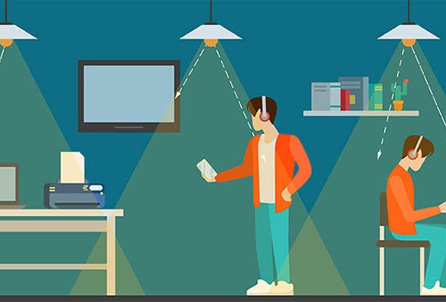
LIFI
LIFI
LIGHT+WIFI

Slide 2
ORIGIN
It’s a play on WiFi which actually stands for Wireless Fidelity - but that doesn’t really mean anything. The actually technology was Wireless LAN (which initially was Ethernet mapped on to radio) and the WiFi Alliance formed to make sure everyone’s kit worked together.
When they decided to a similar service based on light, they just picked the name LiFi to show it could be used in a similar fashion.

Slide 3
Source
Li-Fi is a technology for wireless communication between devices using light to transmit data and position. In its present state only LED lamps can be used for the transmission of visible light. The term was first introduced by Harald Haas during a 2011 TEDGlobaltalk in Edinburgh.^{[2]} In technical terms, Li-Fi is a visible light communicationssystem that is capable of transmitting data at high speeds over the visible light spectrum, ultraviolet and infrared radiation.

Slide 4
Source
In terms of its end use the technology is similar to Wi-Fi. The key technical difference is that Wi-Fi uses radio frequency to transmit data. Using light to transmit data allows Li-Fi to offer several advantages like working across higher bandwidth working in areas susceptible to electromagnetic interference (e.g. aircraft cabins, hospitals) and offering higher transmission speeds.The technology is actively being developed by several organizations across the globe

Slide 5
Pioneers
PureLiFi demonstrated the first commercially available Li-Fi system, the Li-1st, at the 2014 Mobile World Congress in Barcelona.
Bg-Fi is a Li-Fi system consisting of an application for a mobile device, and a simple consumer product, like an IoT (Internet of Things) device, with color sensor, microcontroller, and embedded software. Light from the mobile device display communicates to the color sensor on the consumer product, which converts the light into digital information. Light emitting diodes enable the consumer product to communicate synchronously with the mobile device.

Slide 6
Application
Security
In contrast to radio frequency waves used by Wi-Fi, lights cannot penetrate through walls and doors. This makes it more secure and makes it easier to control access to a network.As long as transparent materials like windows are covered, access to a Li-Fi channel is limited to devices inside the room.

Slide 7
Application
Hospital
Many treatments now involve multiple individuals,Li-Fi systems could be a better system to transmit communication about the information of patients. Besides providing a higher speed, light waves also have little effect on medical instrumentsand human bodies.

Slide 8
Application
Underwater application
Most remotely operated underwater vehicles (ROVs) are controlled by wired connections. The length of their cabling places a hard limit on their operational range, and other potential factors such as the cable's weight and fragility may be restrictive. Since light can travel through water, Li-Fi based communications could offer much greater mobility. Li-Fi's utility is limited by the distance light can penetrate water. Significant amounts of light do not penetrate further than 200 meters. Past 1000 meters, no light penetrated

Slide 9
Application
Vehicles could communicate with one another via front and back lights to increase road safety. Street lights and traffic signals could also provide information about current road situations.

Slide 10
Application
Industrial automation:
Anywhere in industrial areas data has to be transmitted, Li-Fi is capable of replacing slip rings, sliding contacts and short cables, such as Industrial Ethernet. Due to the real time capability of Li-Fi (which is often required for automation processes) it is also an alternative to common industrial Wireless LAN standards

Slide 11
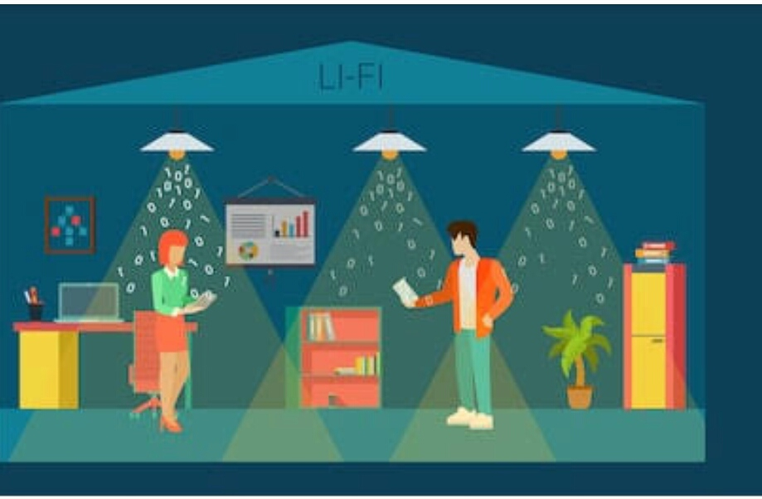
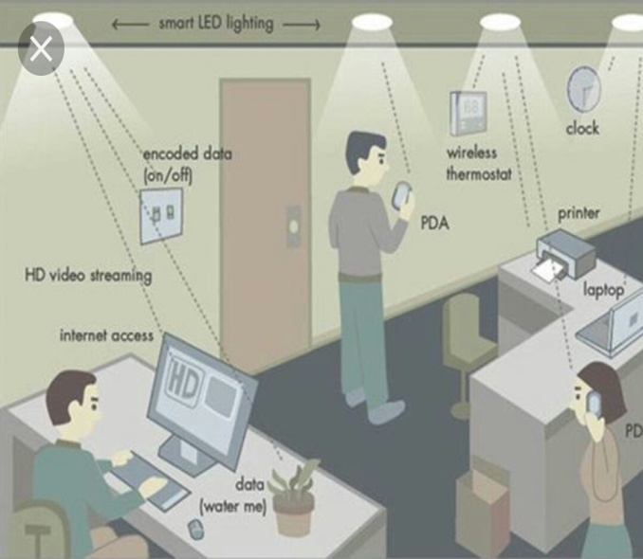
Lifi

